Slide 1
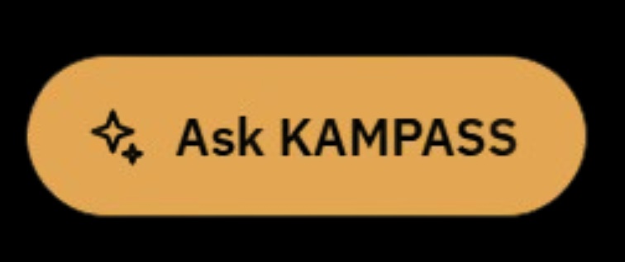
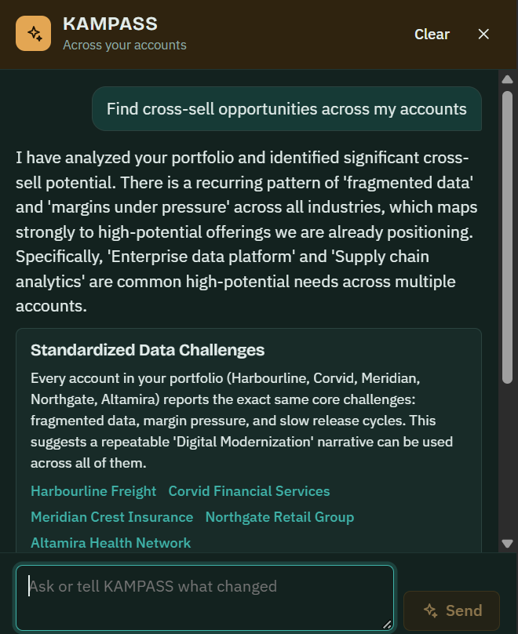
KAMPASS
The compass for every key account
KAMPASS brings strategic planning, predictive AI and operational data into one system for leaders of Micro and Macro Account Clusters.
KNOW YOUR PORTFOLIO MORE THAN EVER
Notes:
Open with the answer. KAMPASS is the compass for every key account: one system that plans, predicts and runs the account. The screen on the right is the live product. A leader asks for cross-sell opportunities across their accounts, and KAMPASS reads the whole portfolio, finds the shared pattern and names the offerings to position.

Slide 2
STRATEGIC · PREDICTIVE AI · AGENT ·
KAMPASS helps Key Account leaders plan, decide and grow across every Micro and Macro Account Cluster
ACCOUNT MANAGER
EXECUTIVE
01
02
03
Plan
Decide
Grow
See: the full portfolio in one view
One live account plan per cluster, with priorities, owners and targets
Actions ranked by expected impact, using predicted risk and opportunity
Growth levers identified per account and tracked through to revenue
Anticipate: risks and opportunities ranked by value
Invest: talent decisions linked to account growth
OUTCOME
OUTCOME
OUTCOME
Every account runs on one current, shared plan
Faster decisions grounded in forward-looking data
Sustained, measurable growth in account revenue
Source: [Pilot data, period]; bracketed figures to be completed
02
Notes:
The strategic side of Key Account Management. Read the three columns in order: plan, decide, grow. For each, say what KAMPASS does, then the outcome the account sees and the target figure.

Slide 3
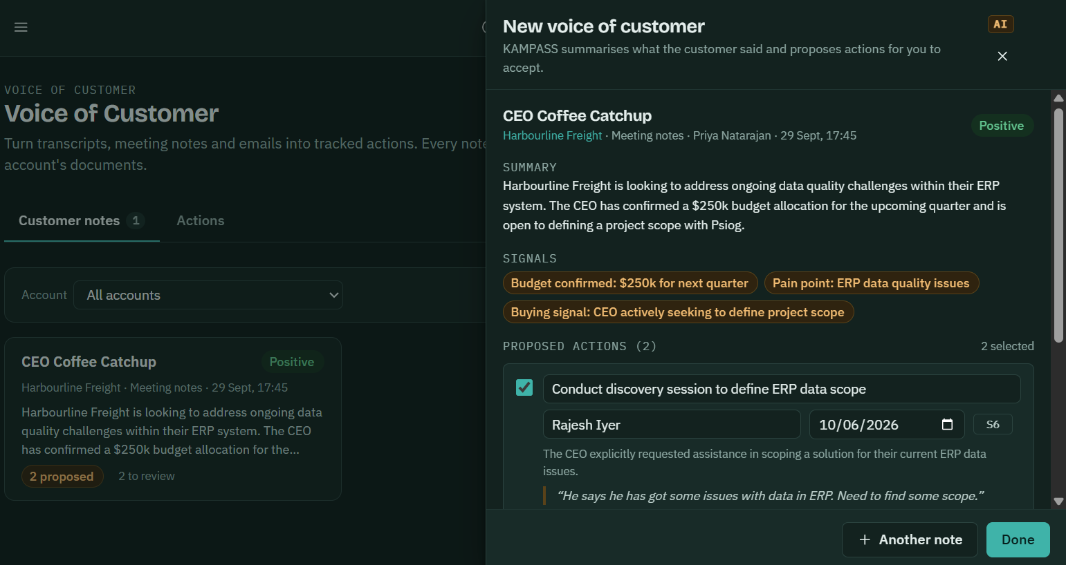
STRATEGIC · PREDICTIVE AI · AGENT ·
Predictive AI built into KAMPASS forecasts operational and execution outcomes before they occur
01 · SIGNALS IN
Account and delivery data
Meeting notes, pipeline, revenue, timesheets, allocation and skills
02 · PREDICTIVE ENGINE
What KAMPASS forecasts
Execution risk, growth trajectory, utilization and skill gaps
03 · INSIGHTS OUT
Delivered to the leader
Signals, early warnings and proposed actions with owner and date
From one meeting note: budget, pain point and buying signal extracted, and two actions proposed with owner and date
AI shown in lime · Screen: KAMPASS Voice of Customer
03
Notes:
This is the core differentiator. On the left, the flow: the data KAMPASS reads, what the predictive engine forecasts, and what reaches the leader. On the right, the live product doing it. A CEO coffee catch-up becomes a summary, three signals (a confirmed budget, a pain point and a buying signal) and two proposed actions with owner and due date, each traced back to what the customer actually said. The leader accepts or edits; nothing is actioned without them.

Slide 4


STRATEGIC · PREDICTIVE AI · AGENT ·
The 6 KAMPASS agents reads the account, decides the next play and briefs the captain
1 · READS
2 · DECIDES
3 · CAPTAIN ACTS
Opportunities
Feature builder
Today’s plays
value, stage, effort
Rebuilds account state at each stage
ranked by value
Offerings
Account
what follows what
Five models
AI
verdict and plan
Win probability, forecast close
Pursuit team, adjacent plays
Next best action
Stakeholders
Meeting brief
roles, perception
prepared per person
Outcomes
Recommendation layer
Outcome tap
won, lost, context
Plays, verdict, plan, brief
landed, partly, none
Every outcome and override re-scores the play immediately and retrains the models monthly
AI shown in lime · The captain makes every final call
04
Notes:
This is how the agent works. It reads four kinds of account data, rebuilds the account state, runs five predictive models and turns the results into plays, a verdict, a plan and a meeting brief. The captain acts on them and taps the outcome. That outcome flows straight back: it re-scores the play at once and retrains the models every month, so the agent gets sharper with every cycle.

Slide 5

PREDICTIVE AI · AGENT · OPERATIONS
FUTURE ROADMAP…
The KAMPASS operational master links account growth to associate growth and utilization
Timesheets
Allocation
Skill set
Utilization reports
Effort logged by associate, project and account
Who is deployed on which account, and at what share
Skills, proficiency and certifications per associate
Billable and non-billable utilization over time
FOR THE KAM
FOR THE KAM
FOR THE KAM
FOR THE KAM
Actual effort against plan per cluster
Bench, over-allocation and coverage gaps
Skill fit against upcoming demand
Trends by account, cluster and role
GROWTH LOGIC
Associate growth
Higher-value utilization
Account growth
New skills, certifications, role progression
Right skills on the right accounts
Wider scope, more revenue per associate
The operational master also feeds the predictive engine and the agent
05
Notes:
The operational side of Key Account Management. Four modules form the operational master: timesheets, allocation, skill set and utilization reports. The band at the bottom is the core argument: account growth follows associate growth, through better use of the right skills on the right accounts. The same data feeds the predictive engine and the agent from the previous two slides.

